Slide 1
Management Stephen P. Robbins | Mary Coulter Thirteenth Edition
Chapter 3 Managing the Environment and the Organization’s Culture

Slide 2
Learning Objectives
Contrast the actions of managers according to the omnipotent and symbolic views.
Describe the constraints and challenges facing managers in today’s external environment.
Develop your skill at scanning the environment so you can anticipate and interpret changes taking place.=
Discuss the characteristics and importance of organizational culture.
Know how to read and assess an organization’s culture
Describe current issues in organizational culture.
© Pearson Education Limited 2016

Slide 3
The Manager: Omnipotent or Symbolic?
Omnipotent view of management: The view that managers are directly responsible for an organization’s success or failure.
Symbolic view of management: The view that much of an organization’s success or failure is due to external forces outside managers’ control.
© Pearson Education Limited 2016

Slide 4
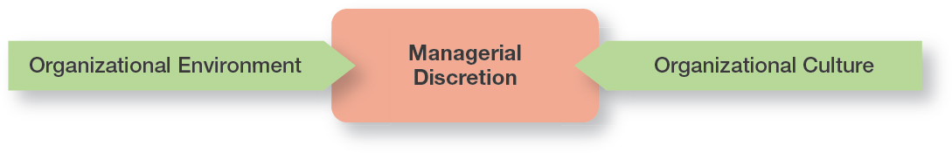
Exhibit 3-1 Constraints on Managerial Discretion
In reality, managers are neither all-powerful nor helpless. But their decisions and actions are constrained.
© Pearson Education Limited 2016

Slide 5
The External Environment
Constraints and Challenges
© Pearson Education Limited 2016

Slide 6
The External Environment
Those factors and forces outside the organization that affect it’s performance. The external environment includes several different components.
Economic – Encompasses factors such as interest rates, inflation, changes in disposable income, stock market fluctuations, and business cycle stages
Demographic – Concerned with trends in population characteristics such as age, race, gender, education level, geographic location, income and family composition
Political/Legal – Concerned with federal, state and local laws, and global laws
© Pearson Education Limited 2016

Slide 7
The External Environment
Technological – Concerned with scientific or industrial innovations
Sociocultural – Concerned with societal and cultural factors such as values, attitudes, trends, traditions and lifestyles, beliefs, tastes, and patterns of behavior
Global – Encompasses issues associated with globalization and a world economy
© Pearson Education Limited 2016

Slide 8
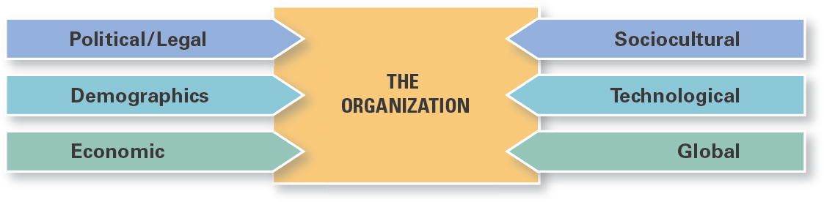
Exhibit 3-2 Components of External Environment
© Pearson Education Limited 2016

Slide 9
The Economic Environment
Like many global businesses, Nestlé is facing increased commodity (raw materials) costs.
Nestlé, the maker of products from Crunch chocolate bars to Nescafé coffee to Purina pet foods, spends more than $30 billion a year on raw materials.
Commodity costs are just one of the many volatile economic factors facing organizations. Managers need to be aware of the economic context so they can make the best decisions for their organizations.
© Pearson Education Limited 2016

Slide 10
The Global Economy and the Economic Context
The lingering global economic challenges – once described as the “Great Recession” by some analysts – began with the turmoil in the United States housing market.
As credit markets collapsed, businesses were impacted
Credit was no longer readily available to fund businesses
Economic difficulties spread across the globe
The fragile economic recovery continues to be a business constraint
© Pearson Education Limited 2016

Slide 11
Economic Inequality and the Economic Context
As economic growth has languished and sputtered, and as people’s belief that anyone could prosper declined, social discontent over growing income gaps has increased.
Business leaders must realize that societal attitudes in the economic context have the potential to create constraints.
© Pearson Education Limited 2016

Slide 12
The Demographic Environment
The size and characteristics of a country’s population can have a significant effect on what it’s able to achieve in politics, economics, and culture.
Baby Boomers – Born between 1946 and 1964, one of the largest and most influential demographic groups in history.
Gen Y or (Millennials) – Children of Baby Boomers, born between 1978 and 1994, making an impact on technology and the workplace.
Post-Millennials – The youngest group identified age group—basically teens and middle-schoolers. They have also been called the iGeneration because advances in technology have customized everything to the individual.
© Pearson Education Limited 2016

Slide 13
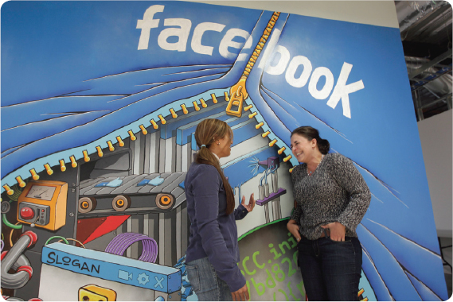
The Demographic Environment
Gen Y is an important demographic at Facebook, where most employees are under 40. The company values the passion and pioneering spirit of its young employees who embrace the challenges of building groundbreaking technology and of working in a fast-paced environment with considerable change and ambiguity.
© Pearson Education Limited 2016

Slide 14
How the External Environment Affects Managers
What the various components of the external environment are and examining certain aspects of that environment are important to managers.
How the environment affects managers is equally as important.
Three ways the environment constrains and challenges managers are:
Jobs and employment
Environmental uncertainty
Stakeholder relationships
© Pearson Education Limited 2016

Slide 15
Jobs and Employment
As any or all external environmental conditions change, one of the most powerful constraints managers face is the impact of such changes on jobs and employment.
Last Global Recession (2008)
Millions of jobs were eliminated
Increase in unemployment rates
Many college grads have struggled to find jobs or ended up taking jobs that don’t require a college degree
Such adjustments, created challenges for managers who must balance work demands and having enough of the right types of people with the right skills to do the organization’s work.
© Pearson Education Limited 2016

Slide 16
Jobs and Employment
External Environment affect how those jobs are created and managed.
Many employers use flexible work arrangements to meet work output demand
Work tasks may be done by freelancers hired to work on an as-needed basis or by temporary workers who work full-time but are not permanent employees, or by individuals who share jobs
As a manager, you’ll need to recognize how these work arrangements affect the way you plan, organize, lead, and control.
© Pearson Education Limited 2016

Slide 17
Assessing Environmental Uncertainty
Environmental uncertainty refers to the degree of change and complexity in an organization’s environment.
The dimensions of uncertainty are:
1. Degree of Change
Organizations are stable, minimal change
Organizations are dynamic, frequent change
2. Degree of Environmental Complexity
The number of components in an organization’s environment and the extent of the organization’s knowledge about those components.
© Pearson Education Limited 2016

Slide 18
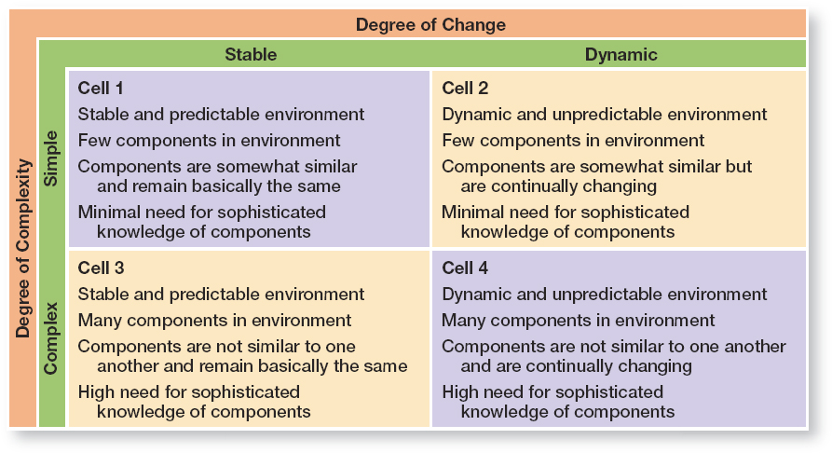
Exhibit 3-3 Environmental Uncertainty Matrix
© Pearson Education Limited 2016

Slide 19
Managing Stakeholder Relationships
The nature of stakeholder relationships is another way in which the environment influences managers. The more obvious and secure these relationships, the more influence managers will have over organizational outcomes.
Stakeholders – any constituencies in the organization’s environment affected by an organization’s decisions and actions.
Exhibit 3-4 identifies some of the organization’s most common stakeholders which includes both internal and external constituent groups.
© Pearson Education Limited 2016

Slide 20
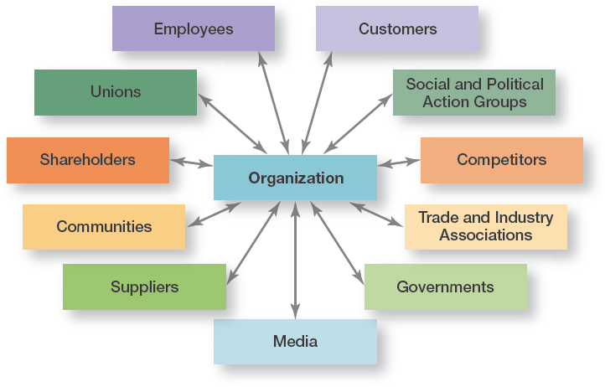
Exhibit 3-4 Organizational Stakeholders
© Pearson Education Limited 2016

Slide 21
Benefits of Good Stakeholder Relationships
Lead to desirable organizational outcomes such as improved Predictability of environmental changes
More successful innovations
Greater degree of trust among stakeholders
Greater organizational flexibility to reduce the impact of change
Affect organizational performance if managers consider the interests of all major stakeholder groups as they make decisions
© Pearson Education Limited 2016

Slide 22
Organizational Culture
Constraints and Challenges
© Pearson Education Limited 2016

Slide 23
Organizational Culture
Just as each individual has a unique personality — traits and characteristics influence the way we act and interact with others. An organization, too, has a personality, which is referred to as organizational culture.
An organization’s culture can make employees feel included, empowered, and supported or it can make them feel the opposite.
© Pearson Education Limited 2016

Slide 24
Organizational Culture
Organizational Culture —The shared values, principles, traditions, and ways of doing things that influence the way organizational members act and that distinguish the organization from other organizations.
Cultural values and practices evolve over time.
Organizational Culture is:
Perception — based on employee experience within the organization
Descriptive — how members describe it
Shared — employees share perception and experiences
Research suggests seven dimensions of culture that seem to capture the essence of an organization’s culture:
© Pearson Education Limited 2016

Slide 25
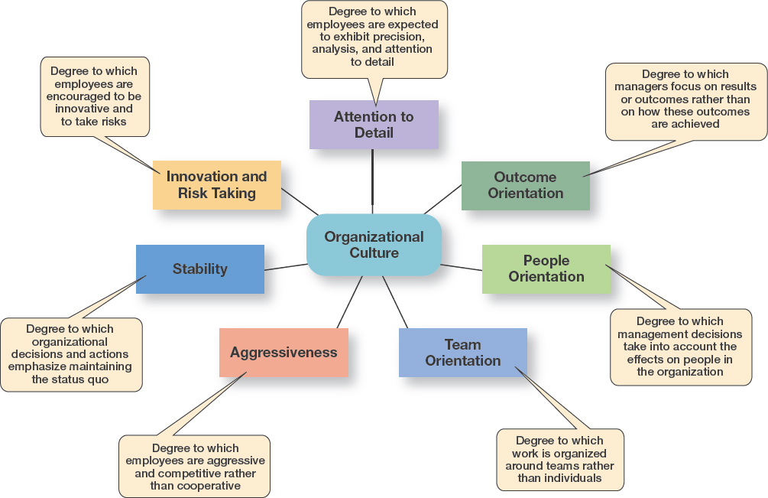
Exhibit 3-5 Dimensions of Organizational Culture
© Pearson Education Limited 2016

Slide 26
Contrasting Organizational Culture
In many organizations, one cultural dimension often is emphasized more than the others and essentially shapes the organization’s personality and the way organizational members work.
For example:
Sony Corporation focuses on product innovation and risk-taking. The company “lives and breaths” innovations, and employees’ behaviors support that goal. (Product Orientation).
Conversely, Southwest Airlines focuses on it’s employees and has made them a central focus of it’s culture. (People Orientation).
© Pearson Education Limited 2016

Slide 27
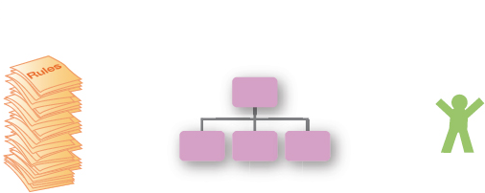
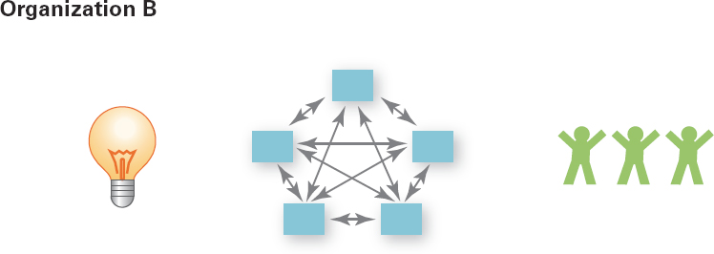
Contrasting Organizational Culture
Organization A
Risk-taking and change discouraged
Creativity discouraged
follow extensive rules and regulations
Close managerial supervision
Work activities designed around the individual employee
Performance evaluations and rewards are based on individual efforts and seniority
Organization B
Risk-taking and change rewarded
Creativity and innovation rewarded
few rules and regulations for employees to follow
Management trusts employees
Work designed around teams
Bonuses are based on achievement of outcomes
© Pearson Education Limited 2016

Slide 28
Strong Cultures
All organizations have cultures, but not all cultures equally influence employees’ behaviors and actions.
Strong Cultures — Organizational cultures in which the key values are intensely held and widely shared.
The more employees accept the organization's key values and greater their commitment to those values, the stronger the culture.
The stronger the culture becomes, the more it affects the way managers plan, organize, lead, and control.
Strong Cultures are associated with high organizational performance.
© Pearson Education Limited 2016

Slide 29
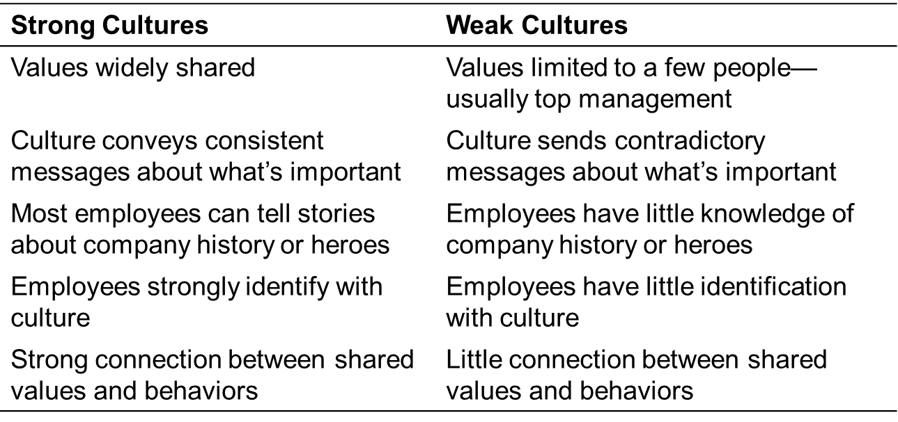
Exhibit 3-7 Contrasting Organizational Culture
© Pearson Education Limited 2016

Slide 30
Strong Cultures
Apple’s strong culture of product innovation and customer-service reflects the core values of it’s visionary co-founder, Steve Jobs. Jobs instilled these core values in all employees, from top executives to sales associates, such as the Genius Bar employee shown here training a customer at the Apple Store in Manhattan.
© Pearson Education Limited 2016

Slide 31
Where Culture Comes From and How It Continues
Exhibit 3-8 illustrates how an organization’s culture is established and maintained.
The original source of the culture usually reflects the vision of the founders. The small size of most new organizations makes it easier to instill the vision with all organizational members.
Once the culture is established, organizational practices help maintain it.
For instance, during the employee selection process, managers typically judge job candidates not only on the job requirements, but also on how well they might fit into the organization. At the same time, job candidates find out information about the organization and determine whether they are comfortable with what they see.
© Pearson Education Limited 2016

Slide 32
Where Culture Comes From and How It Continues
The actions of top managers also have a major impact on the organization’s culture Through what they say and how they behave, top managers establish norms that filter down through the organization and can have a positive effect on employees’ behaviors.
Finally, organizations help employees adapt to the culture through socialization, a process that helps new employees learn the organization’s way of doing things.
Employees understand the culture and are enthusiastic and knowledgeable with customers.
Minimizes the chance that new employees might disrupt current beliefs and customs.
© Pearson Education Limited 2016

Slide 33
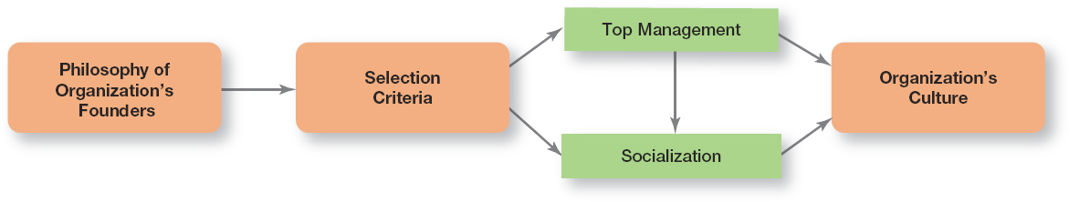
Exhibit 3-8 Establishing and Maintaining Culture
© Pearson Education Limited 2016

Slide 34
How Employees Learn Culture
Employees “learn” an organization’s culture in a number of ways. The most common are:
Stories
Rituals
Material Symbols
Language
© Pearson Education Limited 2016

Slide 35


How Employees Learn Culture
Stories – Organizational “stories” typically contain a narrative of significant events or people, including such things as the organization’s founders, rule breaking, reactions to past mistakes, and so forth.
Example:
At 3M Company, the product innovation stories are legendary. There’s the story about the 3M scientist who spilled chemicals on her tennis shoe and came up with Scotchgard.
There’s the story about Art Fry, a 3M researcher who wanted a better way to mark the pages of his church hymnal and invented the Post-It Note.
© Pearson Education Limited 2016

Slide 36


How Employees Learn Culture
Rituals — repetitive sequences of activities that express and reinforce important organizational values and goals.
Example:
Mark Zuckerberg would end employee meetings by pumping his fist in the air and leading employees in a chant of “domination.”
Mary Kay Cosmetics’ annual awards ceremony for its sales representatives. Salespeople are rewarded for sales goal achievements with an array of expensive gifts, including big-screen televisions, diamond rings, trips, and pink Cadillacs.
© Pearson Education Limited 2016

Slide 37
How Employees Learn Culture
Material Artifacts and Symbols — convey to employees who is important and the kinds of behavior (for example, risk taking, conservative, authoritarian, participative, individualistic, and so forth) that are expected and appropriate.
Example:
The layout of an organization’s facilities, how employees dress and the types of automobiles provided to top executives are examples of material symbols.
Others include the size of offices, the elegance of furnishings, executive “perks” (extra benefits provided to managers such as health club memberships, use of company owned facilities, and so forth), employee fitness centers or on-site dining facilities, and reserved parking spaces for certain employees.
© Pearson Education Limited 2016

Slide 38
How Employees Learn Culture
Language — many organizations or units of an organization use language to identify and unite members of a culture. New employees are frequently overwhelmed with acronyms and jargon that quickly becomes a part of their language.
Example:
At Cranium, a Seattle board game company, “chiff” is used to remind employees of the need to be incessantly innovative in everything they do. “Chiff” stands for “clever, high quality, innovative, friendly, fun.”
© Pearson Education Limited 2016

Slide 39
How Culture Affects Managers
An organization’s culture constrains what managers can and cannot do and how they manage.
As shown in Exhibit 3-9, a manager’s decisions are influenced by the culture in which he or she operates. An organization’s culture, especially a strong one, influences and constrains the way managers plan, organize, lead, and control.
© Pearson Education Limited 2016

Slide 40
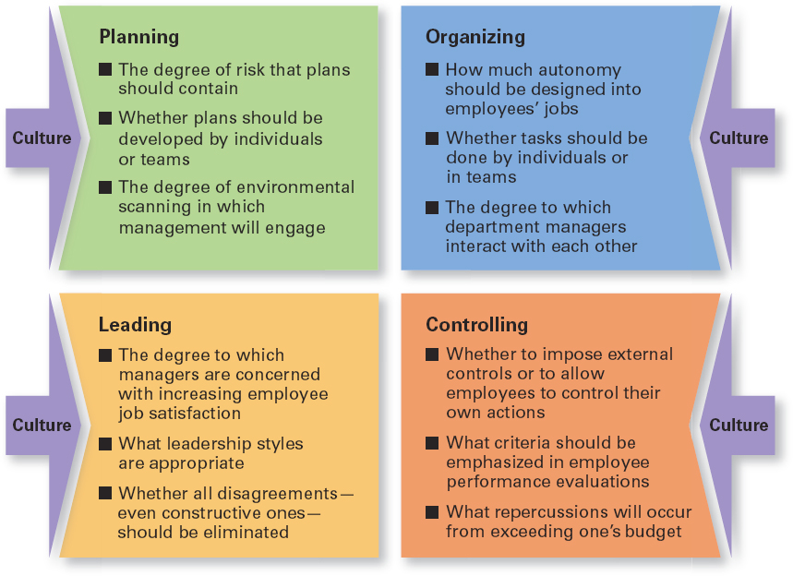
Exhibit 3-9 Types of Managerial Decisions Affected by Culture
© Pearson Education Limited 2016

Slide 41
Current Issues in Organizational Culture
Creating an Innovative Culture Creating a Customer-responsive Culture
© Pearson Education Limited 2016

Slide 42
Creating an Innovative Culture
According to Swedish researcher Goran Ekvall, an innovative culture would be characterized by the following:
Challenge and involvement – are employees involved in, motivated by, and committed to the long-term goals and success of the organization?
Freedom – Can employees independently define their work, exercise discretion, and take initiative in their day-to-day activities?
Trust and openness – Are employees supportive and respectful of each other?
Idea time – Do individuals have time to elaborate on new ideas before taking action?
Playfulness/humor – Is the workplace spontaneous and fun?
Conflict resolution – Do individuals make decisions and resolve issues based on the good of the organization versus personal interest?
Debates – Are employees allowed to express opinions and put forth ideas for consideration and review?
Risk taking – Do managers tolerate uncertainty and ambiguity, and are employees rewarded for taking risks?
© Pearson Education Limited 2016

Slide 43
Creating a Customer-Responsive Culture
Of course managers would want to create a customer-responsive culture!
What does a customer-responsive culture look like?
Exhibit 3-10 describes five characteristics of customer-responsive cultures and offers suggestions as to what managers can do to create that type of culture.
© Pearson Education Limited 2016

Slide 44
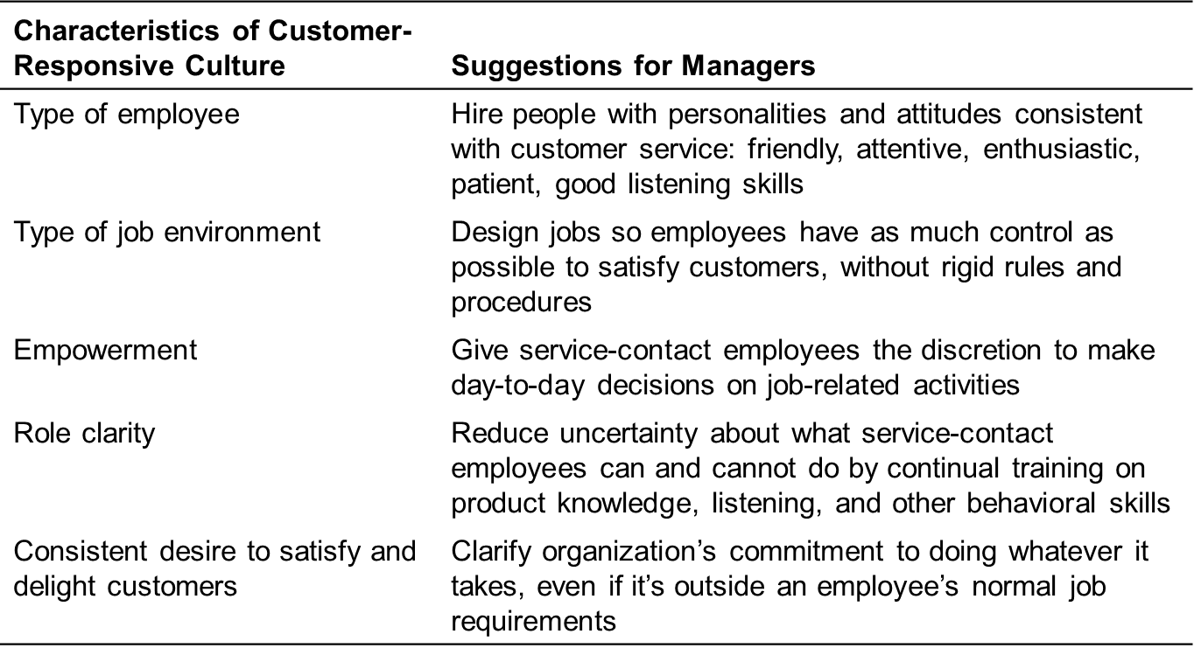
Exhibit 3-10 Creating a Customer-Responsive Culture
© Pearson Education Limited 2016

Slide 45
Review of Learning Objective 3.1
Contrast the actions of managers according to the omnipotent and symbolic views.
Omnipotent View — Managers are directly responsible for the organization’s success or failure.
Symbolic View — Much of the organization’s success or failure is due to external forces outside of the manager’s control.
The two constraints on managers' discretion are organizational culture (internal) and the environment (external).
© Pearson Education Limited 2016

Slide 46
Review of Learning Objective 3.2
Describe the constraints and challenges facing managers in today’s external environment.
The external environment includes those factors and forces outside the organization that affect its performance.
The main components of the external environment are, economic, demographic, political/legal, Sociocultural, technological, and global.
Managers face constraints and challenges from these components because they have an impact on jobs, environmental uncertainty, and stakeholder relationships.
© Pearson Education Limited 2016

Slide 47
Review of Learning Objective 3.3
Discuss the characteristics and importance of organizational culture.
The seven dimensions of culture are: attention to detail, outcome orientation, people orientation, team orientation, aggressiveness, stability, innovation and risk taking.
The stronger the culture, the greater the impact on the way managers plan, organize, lead, and control.
The original source of the organizational culture reflects the founder’s vision.
Culture is transmitted through stories, rituals, material symbols, and language.
© Pearson Education Limited 2016

Slide 48
Review of Learning Objective 3.4
Describe current issues in organizational culture.
The characteristics of an innovative culture are challenge and involvement, freedom, trust and openness, idea time, playfulness/humor, conflict resolution, debates, and risk taking.
A customer responsive culture has five characteristics: outgoing and friendly employees; jobs with few rigid rules, procedures, and regulations; empowerment; clear roles and expectations; and employees who are conscientious in their desire to please the customer.
© Pearson Education Limited 2016

